Slide 1

SkyBMS: Elevating Battery Management with Cloud Intelligence
Empowering batteries through CloudBMS for efficient storage, analytics, and insights in energy management.
Sundeep Dayalan (www.sundeepdayalan.in)

Slide 2

1. Limited storage and computation in diverse Battery Management Systems (BMS) hinder effective handling of sensor-generated data in batteries. 2. Many electrically operated devices lack Battery Management Systems (BMS) capable of providing insightful data on battery performance, limiting monitoring capabilities. 3. Resource constraints in emerging companies impede research and implementation of cloud-based BMS for advanced analytics, restricting optimal battery management.
The Problem

Slide 3

Cloud Integration: Leverage cloud technology for efficient sensor data upload, storage, and advanced analytics. Digital Twin: Create a cloud-based digital twin for each BMS to optimize monitoring and management.
Solution Approach

Slide 4

Implementation
Hardware Setup
Arduino UNO R4 WiFi board
LiPo Fuel Gauge - MAX1704
TP4056 Battery module
Step Up Booster 0.9V-5V To 5V
Temperature sensor
Relays
Hardware Setup
Cloud computation – AWS EC2
AI Model gpt-3.5-turbo – OpenAI
Webserver Server – Nginx

Slide 5

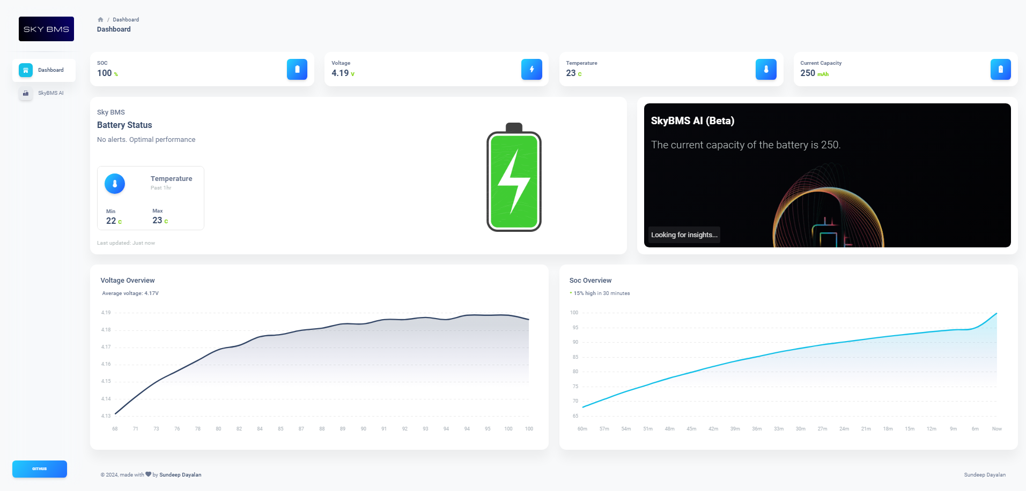
Demo ☺

Slide 6
Questions time!
thank you!

